Slide 1
AVL Trees
CPSC 131 - Data Structures
Shrinivas Patil

Slide 2
Recall: Min and Max Height
(log₂ (n+1)) - 1 ≤ h ≤ n-1
O(log n)
O(n)
4
3
3
2
2
2
1
1
1
1
1
0
0
0
0
0
0
0
0
0

Slide 3
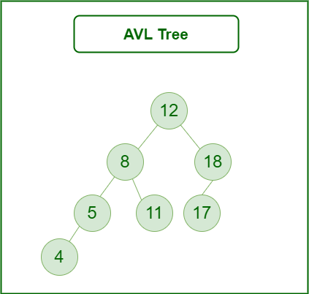
AVL trees
Self balancing Binary Search Tree
Difference between height of left and right subtree should be in the following range: -1<=height(node)<=1
Named After inventors Adelson velsky and lendis

Slide 4
Balance Means Equal Number of Nodes on Both Sides
right-heavy
left-heavy

Slide 5
Balance Factor
Difference between height of left and right subtree of a particular node determines the balance factor of that node.
Balance factor should be -1,0 or 1 for all nodes in order to balance the BST
Calculate Balance factor for given tree

Slide 7
AVL tree Operations
Operations without need of balancing
Create Empty Tree
Search
Height of a tree
Operations with need of balancing
Insert
Delete

Slide 8
What to do If balance factor is not in the range [-1,1] ???
The tree is unbalanced
What you will do to make Unbalanced tree balanced ????

Slide 9
Rotations
Rotations are performed to balance the BST
Rotations are performed in 4 ways:
Left rotation
Right rotation
Left-right rotation
Right-left rotation

Slide 10
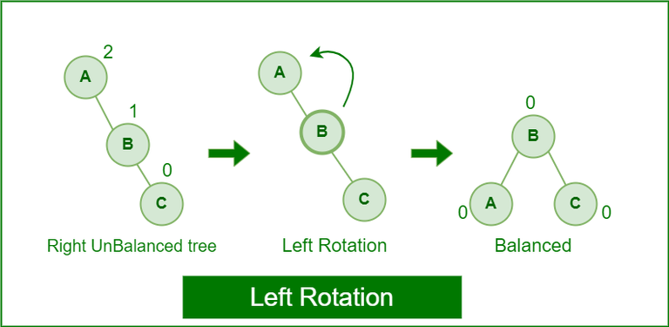
Rotations
Left Rotation:
When node is added to the right of the right subtree (if there is right skewed subtree)
If tree is unbalanced, we will do one left rotation

Slide 11
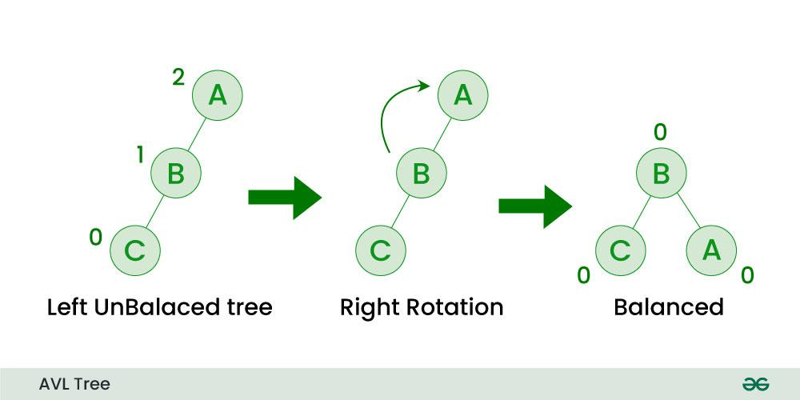
Rotations
Right Rotation:
When node is added to the left of the left subtree (if there is left skewed subtree)
If tree is unbalanced, we will do one right rotation

Slide 12
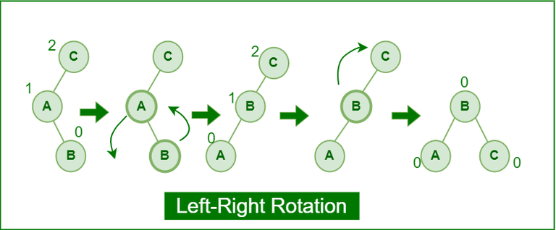
Rotations
Left-Right Rotation:
First left rotation is performed and then right rotation is performed
When you have subtree that goes to left and then it goes to right

Slide 13
Rotations
Right-Left Rotation:
First right rotation is performed and then left rotation is performed
When you have subtree that goes to right and then it goes to left

Slide 14
Insertion in AVL tree
Steps to perform insertion in AVL tree:
Perform BST insertion
Current node will be ancestor of newly inserted node change the height of current node.
Calculate balance factor of current node.
If balance factor is more than 1 then current node is unbalanced and perform LL or L-R case. If balance factor of left child of unbalanced node is greater than equal to 1 then choose LL case otherwise LR
If balance factor is less than -1 then current node is unbalanced and perform RR or R-L case. f balance factor of right child of unbalanced node is less than equal to 0 then choose RR case otherwise RL

Slide 15
Solve the problem for Insertion
Given keys = [40, 20, 10, 25, 30, 22, 50] Construct AVL tree and show rotations.

Slide 16
Deletion in AVL tree
Steps to perform Deletion
Perform deletion as BST
Current node must be ancestor of deleted node. Update the height of current node.
Calculate the balance factor
If balance factor is more than 1 then current node is unbalanced and perform LL or L-R case. If balance factor of left child of unbalanced node is greater than equal to 1 then choose LL case otherwise LR
If balance factor is less than -1 then current node is unbalanced and perform RR or R-L case. f balance factor of right child of unbalanced node is less than equal to 0 then choose RR case otherwise RL

Slide 17
30
10
50
6
18
45
58
5
8
15
47
65
7
9

Slide 18
Applications
used to index huge records in a database
Optimized Search
Corporate areas and storyline games
Memory management
Balanced expression evaluation

Slide 19
Claim: AVL Tree Height is O(log n)
Balance factor of node x:
| height(x.left) - height(x.right) |
AVL Balance Invariant: every node’s balance factor is only 0 or 1
Lemma: Every AVL tree has height O(log n)
Worst-case analysis: what is the maximum height relative to n?
Maximize height relative to nodes = minimize nodes relative to height
Let n_{h} = minimum possible number of nodes in an AVL tree of height h
We analyze n_{h}

Slide 20
Lemma: Every AVL tree has height O(log n)
Root has height h
Definition of height: one child has height h - 1
Other child has height h - 1 or h - 2; assume the worst case (imbalance), h - 2
n_{h} = n_{h-1} + n_{h-2} + 1 (1)
By the same equation, the h-1 subtree has
n_{h-1} = n_{h-2} + n_{h-3} + 1 (2)
Substitute (2) into (1)
n_{h} = (n_{h-2} + n_{h-3} + 1) + n_{h-2} + 1
= 2n_{h-2} + n_{h-3} + 2
1
h
h - 1
h - 2

Slide 21
Lemma: Every AVL tree has height O(log n)
n_{h} = 2n_{h-2} + n_{h-3} + 2
n_{h-3} ≥ 0 and 2 > 0, so
n_{h} > 2n_{h-2}
So n_{h} grows by a factor of 2 every time h increases by 2, and
n_{h} > 2^{h/2} ; take the base-2 logarithm of both sides, and
log₂ (n_{h}) > log₂ (2^{h/2}), and by log rules
log₂ n_{h} > h/2
2 log₂ n_{h} > h
h is O(log n)
1
h
h - 1
h - 2

Slide 22
AVL Tree Analysis
Our proof: h < 2 log₂ n_{h}
More precise proof: h ≲ 1.44 log₂ (n+2) - 0.328
Either way, height h is O(log n)
Search: top-to-bottom, O(1) time per level = O(h) time = O(log n)
Insert
Top-to-bottom search is O(h) = O(log n) time
Create new node = O(1) time
Bottom-to-top restructuring is O(h) = O(log n) time
Total O(log n) + O(1) + O(log n) = O(log n) time
Erase is same O(log n) time as Insert

Slide 23
AVL Tree Asymptotic Efficiency
Operation | BST | Association List | AVL Tree
Constructor (create empty) | O(1) | O(1) | O(1)
Contains(key) | O(n) | O(n) | O(log n)
Find(key) | O(n) | O(n) | O(log n)
Insert(pair) | O(n) | O(n) | O(log n)
Erase(key) | O(n) | O(n) | O(log n)

